Slide 1
Image Sharpening using Knowledge Distillation:
Efficient High-Resolution Image Restoration
Team Members:
Lochan D
Alex Kurian
Vishwaa Patel

Slide 2
Problem Statement & Motivation:
The Challenge of Image Degradation & Computational Cost
Ubiquitous Image Degradation: Digital images frequently suffer from quality degradation (blur, noise, compression artifacts) in real-world scenarios, impacting visual clarity and downstream tasks.
High-Performance Models are Resource-Intensive: State-of-the-art image restoration models, such as RealESRGAN, deliver exceptional results but demand significant computational resources (GPU memory, inference time), limiting their deployment on edge devices or in real-time applications.
Our Motivation: Bridging the Gap with Knowledge Distillation
Efficiency without Compromise: We aim to train a lightweight student model that can replicate the high-fidelity restoration performance of a heavy teacher model at a significantly reduced computational cost.
Enabling Broader Deployment: This approach facilitates the deployment of advanced image sharpening capabilities on devices with limited processing power, such as mobile phones, embedded systems, or IoT devices.

Slide 3
Dataset & Preprocessing:
DIV2K: The Foundation for High-Resolution Image Restoration
Dataset: We utilize the DIV2K High-Resolution Image Dataset, a widely recognized benchmark for image super-resolution, containing diverse high-quality natural images.
Simulating Real-World Degradation
Degradation Process: To simulate common real-world quality losses, we apply a controlled degradation pipeline to the original high-resolution images:
Downsampling: Images are first downscaled (e.g., bicubic interpolation to 128x128).
Upsampling: They are then upscaled back to a larger size (e.g., 256x256) using bicubic interpolation, introducing blur.
Noise Injection: Mild Gaussian noise is added to further mimic real-world sensor noise or compression artifacts.
Purpose: This synthetic degradation process creates realistic low-quality inputs, allowing our models to learn robust restoration capabilities.

Slide 4
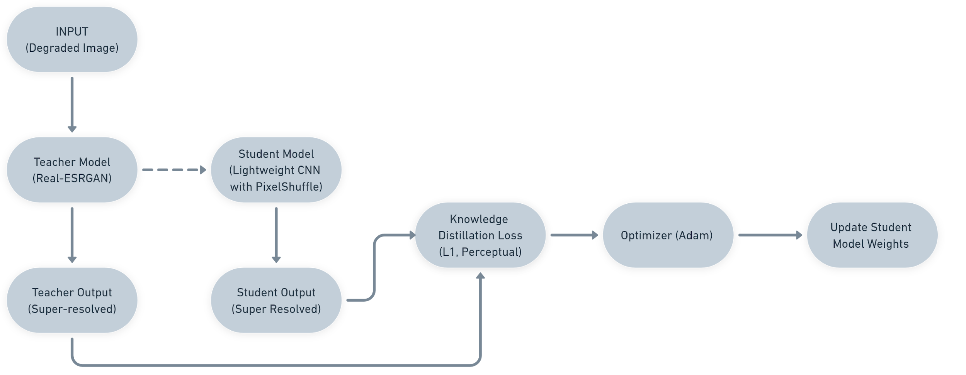
Architecture Diagram:

Slide 5
Model Details:
The Teacher: RealESRGAN - A Powerful Super-Resolution Baseline
Model: RealESRGAN (specifically, the Anime6B variant with an RRDBNet backbone).
Role: Acts as a high-performance, pre-trained oracle. Its parameters are frozen during the student's training.
Upscale Factor: 4x (e.g., 128x128 input to 512x512 output).
The Student: A Compact & Efficient CNN
Model: A custom-designed, lightweight Convolutional Neural Network (StudentCNN).
Architecture Highlights:
Composed of multiple Conv2d layers for feature extraction and transformation.
Employs two PixelShuffle layers to achieve efficient 4x upsampling, converting low-resolution feature maps into high-resolution outputs.
Goal: To achieve comparable performance to the teacher with significantly fewer parameters and faster inference.

Slide 6
Knowledge Distillation Loss Functions
L1 Loss (Pixel-wise Fidelity): Measures the mean absolute error between the student's output and the teacher's output. This ensures pixel-level similarity.
Perceptual Loss (VGG-based, Feature-level Similarity): Utilizes a pre-trained VGG19 network to extract high-level feature representations. The L1 distance between the VGG features of the student's output and the teacher's output is minimized. This loss is crucial for capturing perceptual quality, texture, and visual realism.
Optimizer: Adam (lr = 1e-4)

Slide 7
Algorithm & Training Steps:
Training the Student through Knowledge Distillation
Data Loading: Degraded images and their corresponding high-resolution ground truth images are loaded in batches.
Teacher Inference (Knowledge Generation):
The degraded input batch is fed into the frozen RealESRGAN Teacher Model.
The teacher generates its high-resolution, sharpened output, which serves as the "ground truth" or target for the student.
Student Inference (Learning from Teacher):
The same degraded input batch is passed through the Student CNN.
The student produces its super-resolved output.
Loss Calculation (Mimicking the Teacher):
L1 Loss: Calculated directly between the Student's Output and the Teacher's Output.
Perceptual Loss: Calculated between the VGG features of the Student's Output and the Teacher's Output.

Slide 8
Total Loss: A weighted sum: Total Loss = L1 Loss + 0.1 * Perceptual Loss. The 0.1 weight balances the contribution of perceptual similarity.
Backpropagation & Optimization:
The gradients of the Total Loss are computed with respect to the student model's parameters.
The Adam optimizer updates the student's weights, iteratively guiding it to produce outputs closer to the teacher's.
Iteration: Steps 2-5 are repeated for multiple epochs and batches until the student model converges.

Slide 9
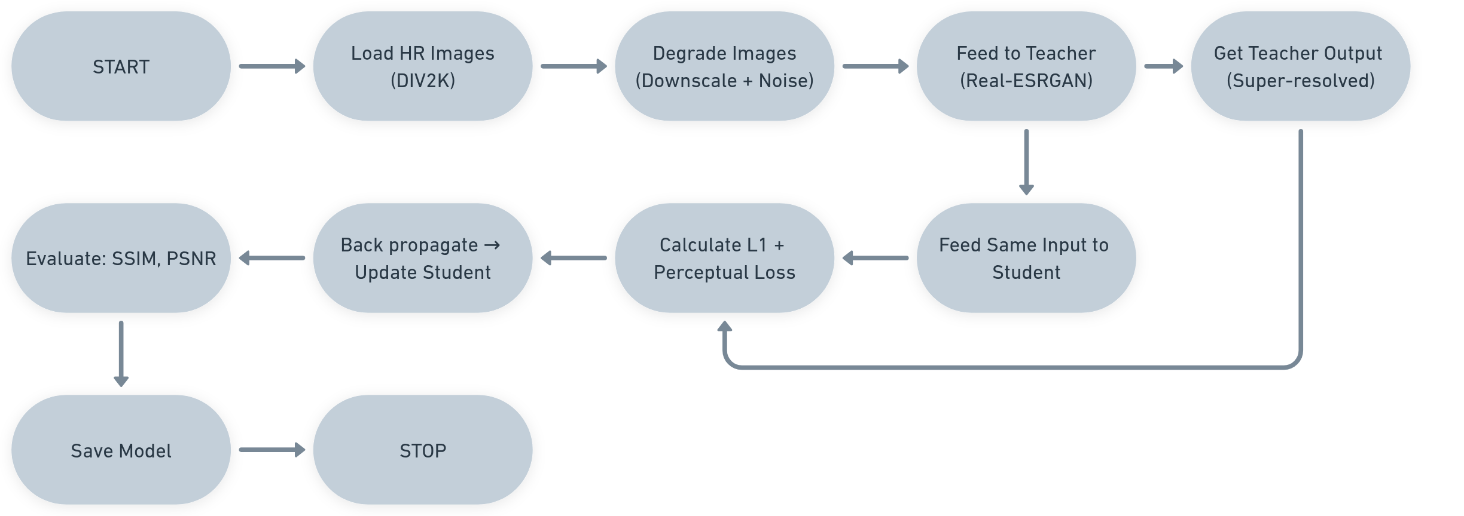
Flowchart:

Slide 10
Results & Metrics:
Dataset: DIV2K High-Resolution Set Degradation: Bicubic downsampling + mild Gaussian noise
Teacher Model: Real-ESRGAN (Anime6B) — high-fidelity super-resolution Student Model: Lightweight CNN with 2× PixelShuffle — optimized for faster inference
Sample Metrics:
PSNR: 28–30 dB (Student)
SSIM: 0.80–0.85 (Student)
Teacher PSNR: ~32–34 dB
Teacher SSIM: ~0.88–0.90

Slide 11
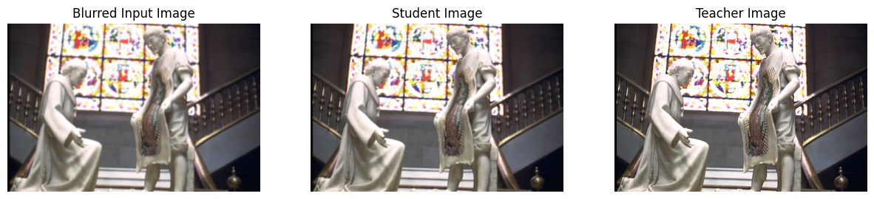
Output:

Slide 12
Contributions:
Lochan D:
Led the overall project design and handled the integration of the Real-ESRGAN Teacher Model.
Designed and implemented the data degradation pipeline and verified the output consistency.
Coordinated the training loops, configured the loss functions (L1, perceptual), and handled the model checkpointing.
Oversaw final report writing, cleaned up the codebase, and ensured smooth execution in Google Colab.
Vishwaa:
Focused on the Student Model architecture, exploring different lightweight CNN designs and implementing PixelShuffle upscaling.
Optimized the training hyperparameters, tested different learning rates and loss weightings.
Contributed significantly to setting up evaluation metrics, including PSNR and SSIM calculations.
Assisted in preparing the visual slides and the architecture flowcharts for the presentation.

Slide 13
Alex Kurian:
Managed dataset curation, ensured all degraded and high-res pairs matched, and prepared the SharpeningDataset class.
Automated the training data loader with augmentations and validated input-output shapes.
Handled testing and evaluation, cross-checking model outputs against the ground truth.
Designed the GitHub repository structure, wrote parts of the README, and finalized the project documentation.

Slide 14
Conclusion:
Conclusion: Efficient Image Sharpening via Knowledge Distillation
This project successfully demonstrates that knowledge distillation is a viable and effective strategy for transferring complex image restoration capabilities from a large, high-performance model (RealESRGAN) to a significantly more lightweight student network.
Our trained student model achieves perceptually pleasing image sharpening from degraded inputs, making advanced restoration accessible for deployment on devices with limited computational resources.

Slide 15
Future Scope:
Future Scope & Enhancements
Student Model Refinement: Explore more advanced lightweight architectures for the student, such as attention-based mechanisms or efficient transformer blocks, to further boost performance.
Advanced Distillation Techniques: Incorporate additional knowledge distillation losses, such as:
Adversarial Distillation: Introduce a lightweight discriminator for the student to generate more perceptually realistic textures.
Feature-map Distillation: Directly align intermediate feature representations between teacher and student.
Real-time Deployment Optimization: Further optimize the student model for even faster inference and explore deployment on specific edge AI hardware (e.g., Intel Movidius, OpenVINO).
Diverse Degradation Models: Train with a wider variety of degradation types to improve robustness to different real-world image quality issues.

Slide 16
References:
Key Resources & Inspirations
Real-ESRGAN GitHub Repository:
https://github.com/xinntao/Real-ESRGAN
DIV2K Dataset:
https://data.vision.ee.ethz.ch/cvl/DIV2K/
PyTorch & TorchVision Documentation:
https://pytorch.org/docs/
https://pytorch.org/vision/stable/index.html
Knowledge Distillation Survey Papers: (Consider adding a relevant survey paper if you referenced one for the concept)
VGG19 Model for Perceptual Loss: (Implicitly referenced through torchvision.models)

